Slide 1
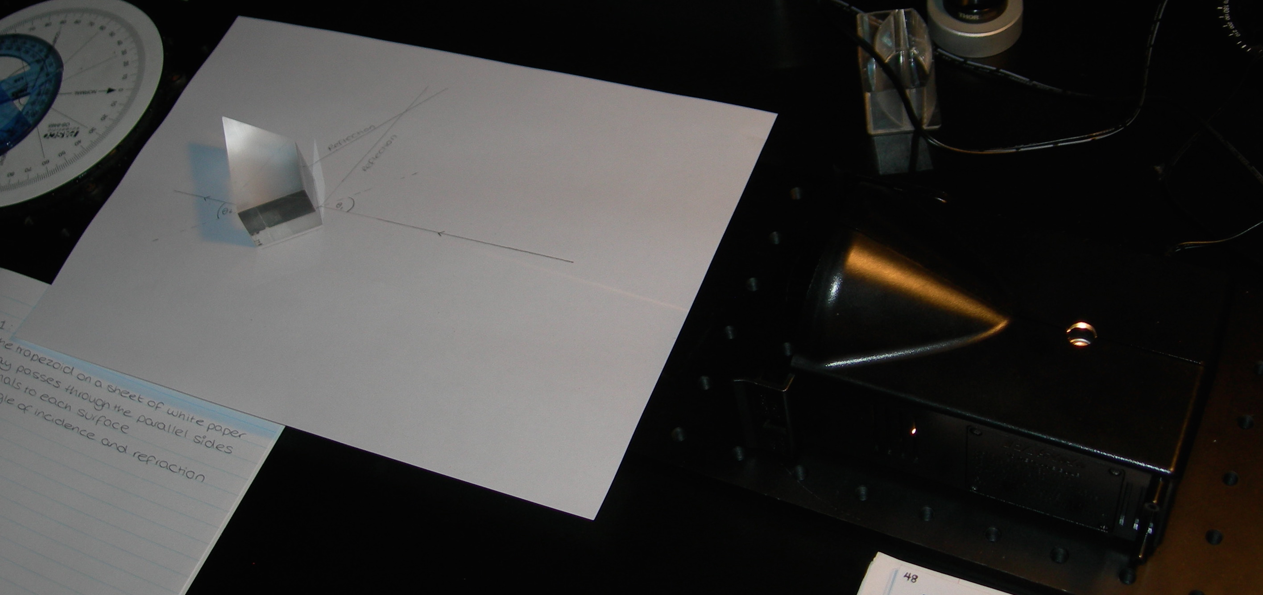
Acrylic Trapezoid
Sketch Outline of Rays and Block on White Paper
Single Ray of White Light Source

